Slide 1




NEXT GEN EMPLOYABILITY PROGRAM
Creating a future-ready workforce
Team Members
College Name
Student Name :Samuel.A
Student ID :au110621104020
NM ID:
INDIRA INSTITUTE OF ENGINEERING AND TECHNOLOGY

Slide 2

CAPSTONE PROJECT SHOWCASE
Project Title
MUSIC WEB APPLICATION USING DJANGO FRAMEWORK
Abstract | Problem Statement | Project Overview | Proposed Solution | Technology Used | Modelling & Results | Conclusion

Slide 3
Abstract:
This project revolves around the development of a music web application utilizing the Django framework, a high-level Python web framework renowned for its simplicity, scalability, and rapid development capabilities. The objective is to create a feature-rich platform where users can discover, organize, and enjoy music content seamlessly.
The project begins with an exploration of the desired features and functionalities of the music web application. We delve into the design phase, outlining the architecture, database schema, and user interface wireframes. Emphasizing Django's built-in features such as authentication, ORM, and templating engine, we establish a solid foundation for development.
testing and debugging are conducted to ensure the reliability and stability of the music web application across different browsers and devices.
Source :

Slide 4
Problem Statement:
User Engagement: One of the primary challenges in developing a music web application using the Django framework is ensuring high user engagement
Content Management: Managing a vast library of music tracks, albums, and artists presents a significant challenge.
Licensing and Copyright Compliance: Ensuring compliance with licensing agreements and copyright laws is essential when dealing with music content
Performance Optimization: Optimizing the performance of the music web application to deliver fast loading times and smooth playback experiences across different devices and network conditions is critical.
Security: Protecting user data, preventing unauthorized access, and mitigating security threats such as SQL injection, cross-site scripting (XSS), and data breaches are critical considerations in developing a secure music web application.
Source :

Slide 5
Project Overview:
User Authentication and Profiles: Implement user registration, login, and profile management features to personalize the user experience and enable access to exclusive content.
Music Content Management: Develop mechanisms for managing music tracks, albums, artists, genres, and playlists to provide users with a diverse and comprehensive music library.
Audio Playback: Integrate audio playback functionality to allow users to listen to music directly within the application, with support for streaming and local file playback.
Search and Discovery: Implement advanced search and recommendation algorithms to help users discover new music based on their preferences, browsing history, and trending content.
Playlist Creation and Sharing: Enable users to create, customize, and share playlists with friends and other users, fostering collaboration and social interaction around music curation.
Social Features: Incorporate social sharing, liking, commenting, and following functionalities to enhance user engagement and community interaction within the platform.
Admin Dashboard: Develop an administrative dashboard with tools for managing users, content, permissions, and analytics to facilitate platform administration and moderation.
Source :

Slide 6
Proposed Solution:
.
The proposed solution is to develop a comprehensive music web application using the Django framework, a powerful and scalable web development framework for Python. The application will offer a wide range of features to cater to the needs of music enthusiasts, providing a seamless and enjoyable experience for discovering, organizing, and enjoying music content.
Key Components:
1.User Authentication and Profiles:
Implement user registration, login, and profile management functionalities.
Allow users to personalize their profiles with profile pictures, bios, and favorite genres.
Ensure secure authentication and session management using Django's built-in authentication system.
2.Music Content Management:
Develop models for representing music tracks, albums, artists, genres, and playlists.
Implement CRUD (Create, Read, Update, Delete) operations for managing music content.
Create admin interfaces for administrators to manage music content efficiently.
Source :

Slide 7
3.Audio Playback Integration:
Integrate third-party libraries or Django packages for audio playback.
Provide features for streaming music tracks, managing playlists, and controlling playback settings.
Ensure smooth and uninterrupted playback experiences for users.
4. Social Features:
Incorporate social sharing, liking, commenting, and following functionalities.
Allow users to share their favorite tracks, playlists, and music discoveries with friends and followers.
Foster community interaction and collaboration around music curation and sharing.
5.Security and Privacy:
Implement robust security measures to protect user data and ensure privacy compliance.
Use encryption, authentication, authorization, and validation techniques to prevent security vulnerabilities.
Regularly update and maintain security protocols to address emerging threats and vulnerabilities.
Source :

Slide 8


Technology Used
Front-end
Back-end
Source :

Slide 9
Modelling & Results:
Modeling:
Database Design: Utilize Django's built-in ORM to design models for representing music tracks, albums, artists, genres, playlists, and user profiles. Define relationships between models such as Many-to-One, Many-to-Many, and One-to-One to establish a cohesive data structure.
User Authentication: Implement Django's user authentication system to manage user registration, login, logout, and profile management functionalities.
Content Management: Develop Django admin interfaces for managing music content, allowing administrators to add, edit, and delete tracks, albums, artists, and genres easily.
Results:
Audio Playback: Users can stream music tracks directly within the application, with support for basic playback controls such as play, pause, skip, and volume adjustment.
Music Content Management: Administrators can manage music content through the Django admin interface, adding new tracks, albums, and artists easily.
Source :

Slide 10
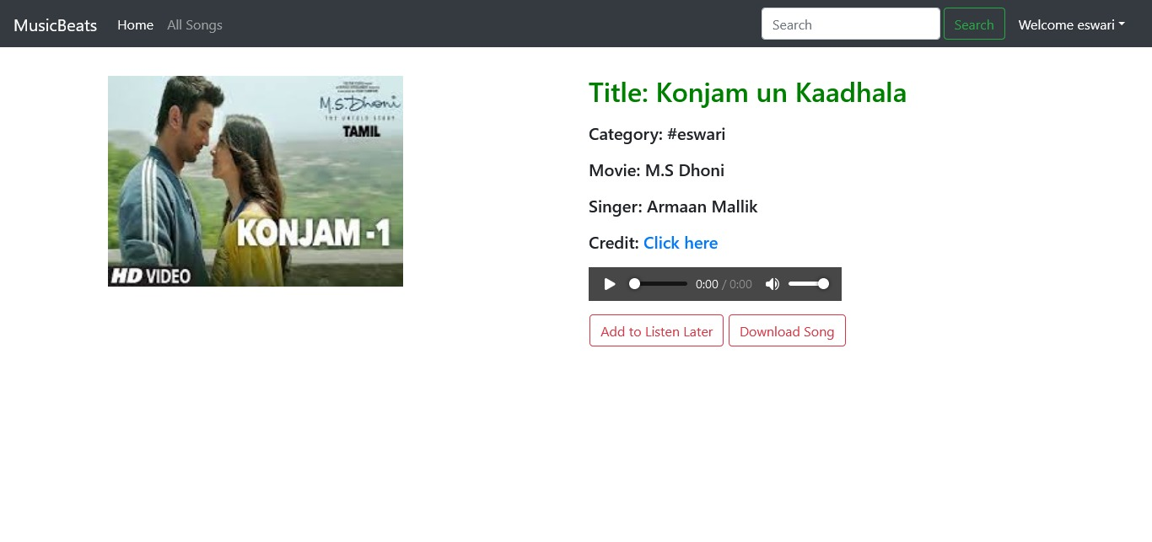

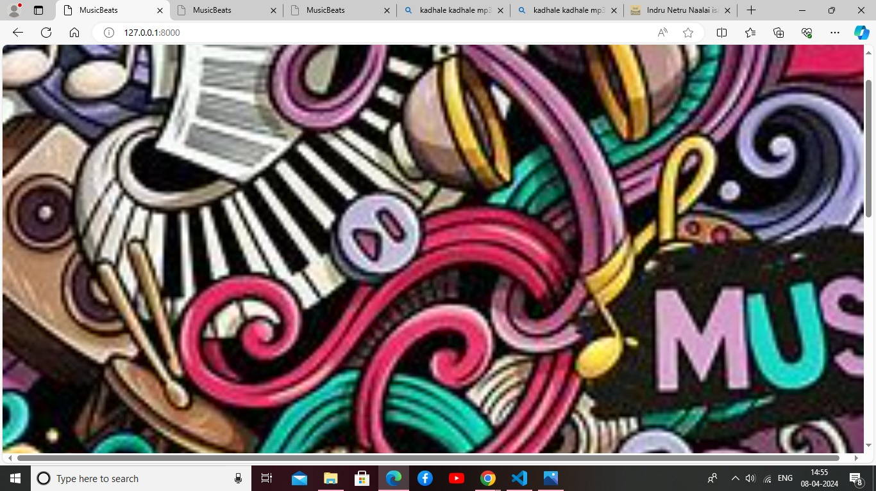
Homepage

Slide 11
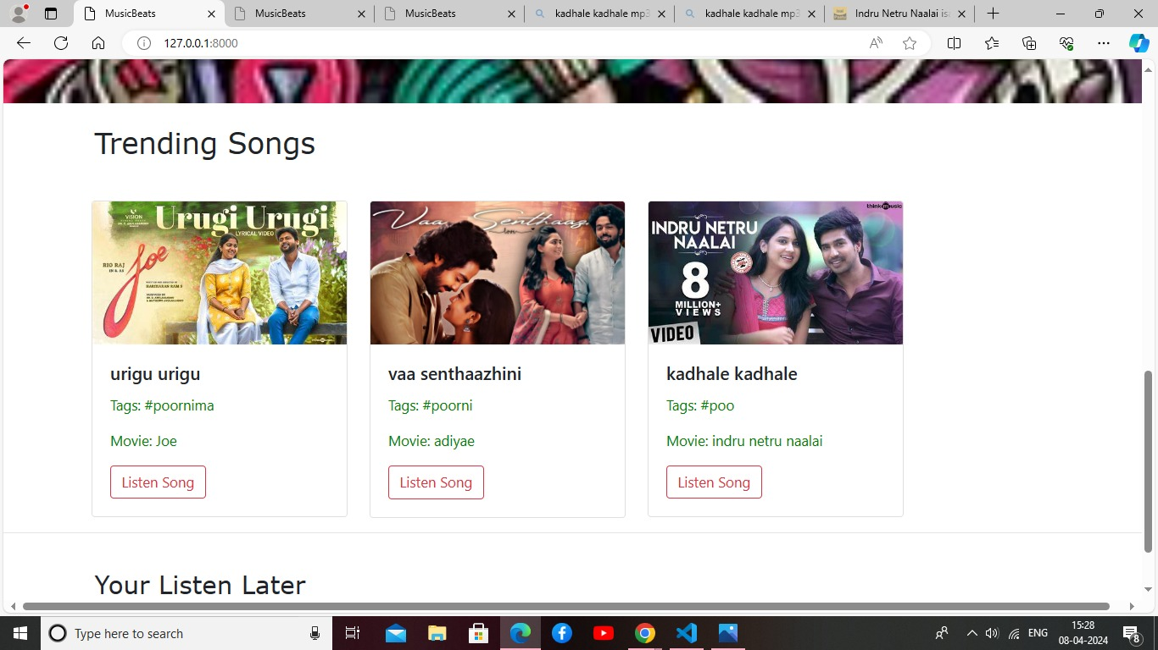
About-Us-Page

Slide 12
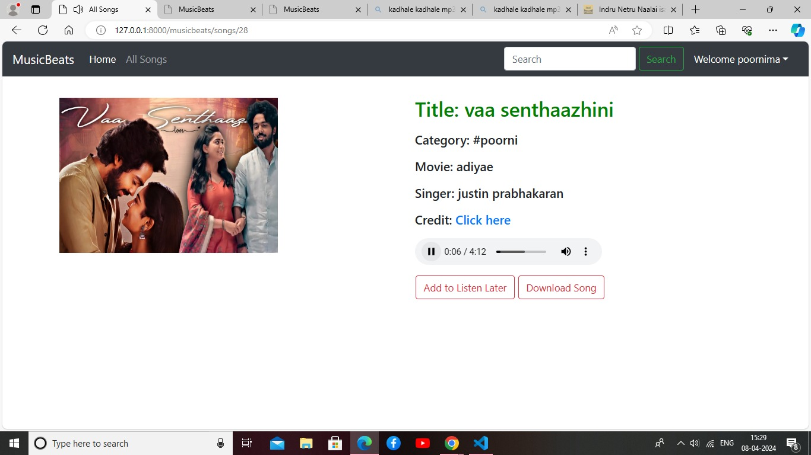
Service-Page

Slide 13
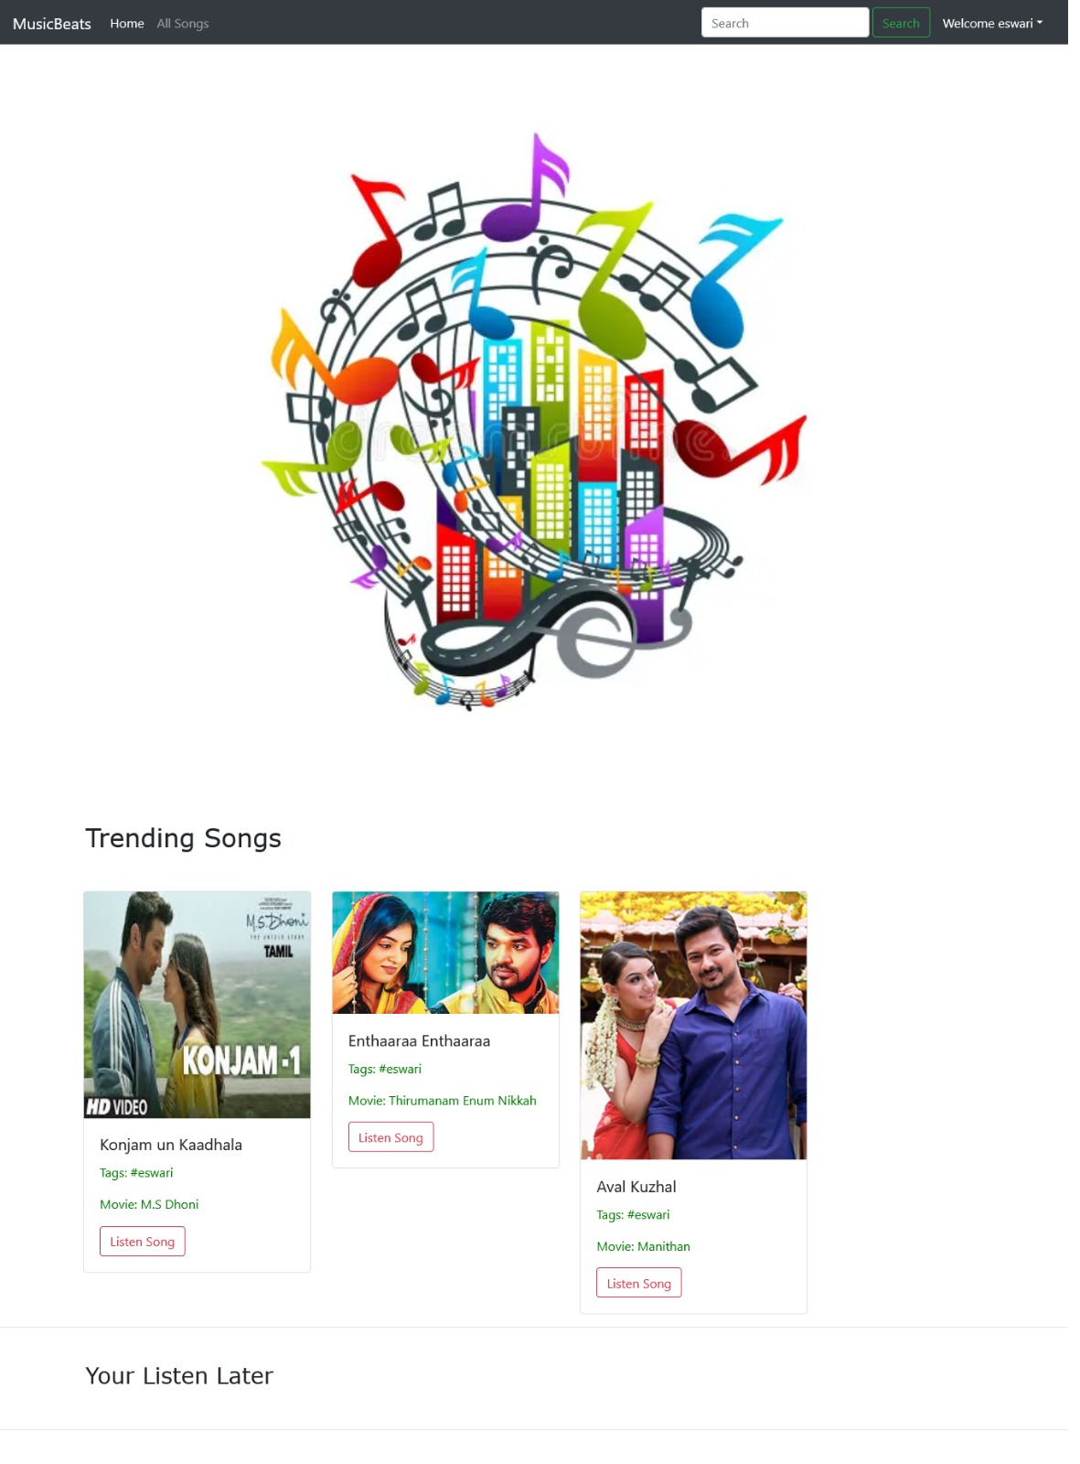
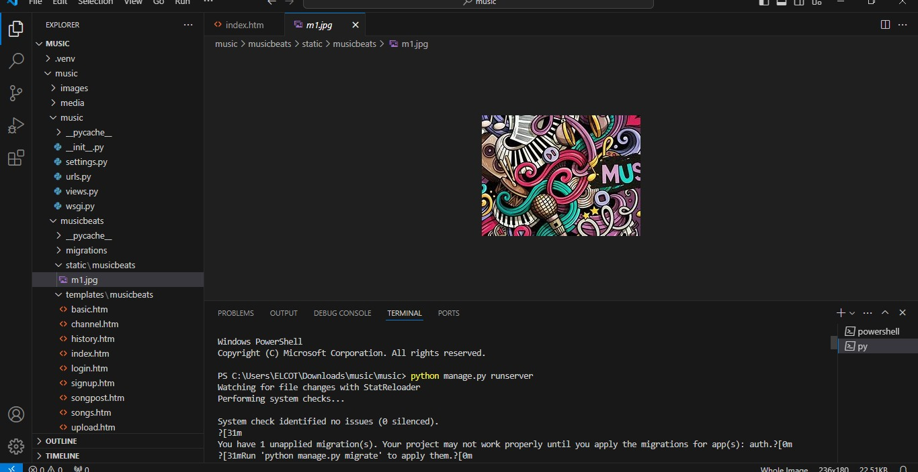
Departments-Page

Slide 14
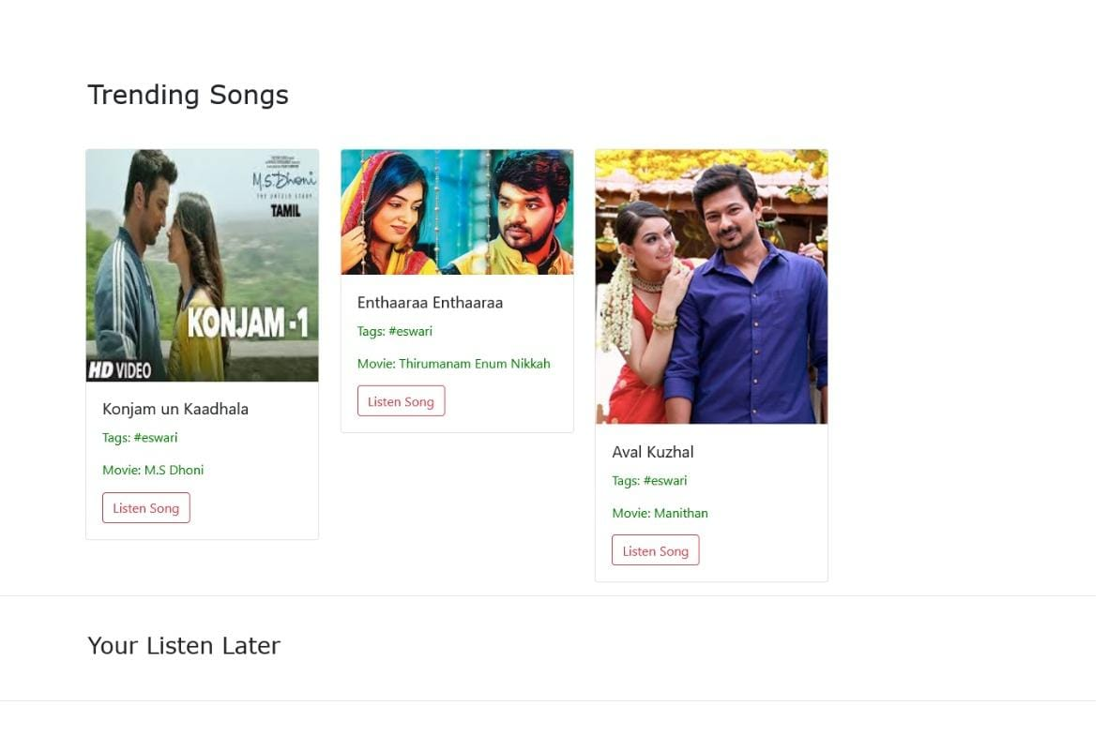
Blog-Page

Slide 15
Future Enhancements:
Offline Mode and Downloading: Implement offline mode functionality, allowing users to download music for offline listening.
Social Integration: Enhance social features by integrating with popular social media platforms, allowing users to share their favorite tracks, playlists, and music discoveries with friends.
Personalized Recommendations: Implement advanced recommendation algorithms based on user listening history, preferences, and behaviors.
Music Discovery Features: Expand music discovery features by incorporating trending charts, new releases, and curated playlists from popular genres and artists.
Collaborative Playlists: Enable collaborative playlist creation, allowing multiple users to contribute and collaborate on playlists together.
Live Streaming and Events: Introduce live streaming capabilities for music performances, concerts, and events within the application.
Audio Content: Expand the platform to include podcasts, audiobooks, and other audio content beyond music.

Slide 16
Conclusion:
The development of a music web application using the Django framework presents an exciting opportunity to create a dynamic and immersive platform for music enthusiasts. Throughout this project, we have explored various challenges, strategies, and future enhancements that contribute to the success and evolution of the application.
This project, we have not only built a music web application but also laid the groundwork for a thriving community of music lovers united by their passion for great music and technology.
Source :

Slide 17
Thank You!
Notes:
Thank You !!

